Slide 1
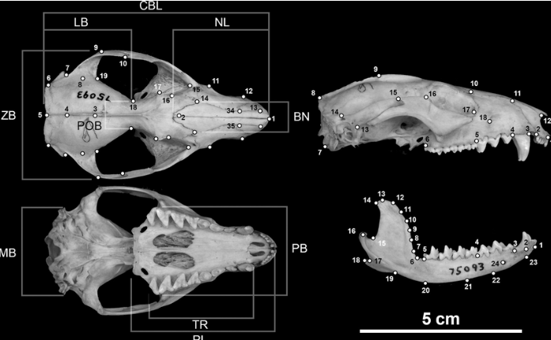
Predictive Modeling and Analysis of Possum Morphometrics:
A Regression Approach
GROUP NUMBER 2
BHAVAN’S VIVEKANANDA COLLEGE.
GROUPMEMBERS:
B.HARSHIT KUMAR,
SRIKANTH YADAV,
CHAITANYA JADAV.

Slide 2
Abstract:
This study applies regression analysis to the possum dataset to explore relationships between morphological features, such as head length, skull width, and tail length. The goal is to develop predictive models that reveal how these characteristics are interrelated, providing insights useful for species identification and ecological research
Objectives:
1.To identify key relationships between various morphological features of possums using regression analysis.
2.To develop predictive models that estimate specific possum characteristics (e.g., body or head length) based on other physical attributes.
3.To evaluate model accuracy and determine the best predictors among the variables in the dataset.

Slide 3
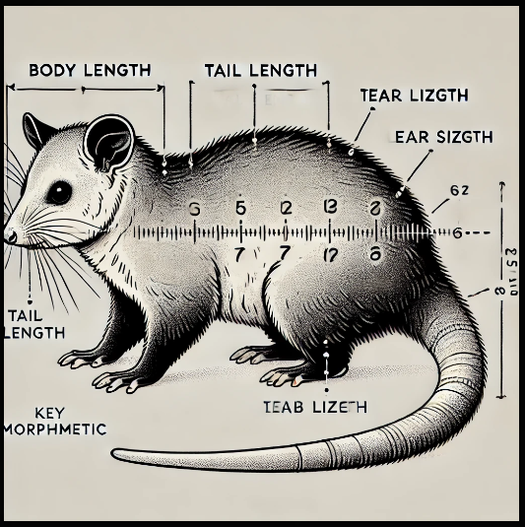
CONTENT
Introduction
Literature Review
Data Preprocessing
Exploratory Data Analysis
Data Modeling and Evaluation
Summary
Appendix

Slide 4
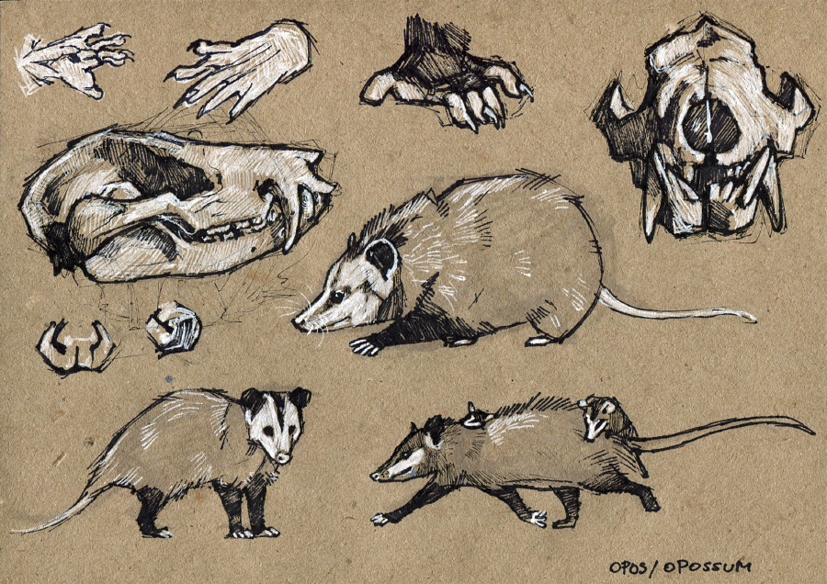
INTODUCTION:
Possums exhibit diverse physical traits that vary across species and habitats. Using the possum dataset, this study applies regression analysis to explore relationships among features like head length, skull width, and tail length. The goal is to identify key predictors and develop models for estimating specific traits based on others. This analysis provides insights into possum morphology, supporting species classification and ecological research.

Slide 5

LITERATURE REVIEW

Slide 6
LITRATURE REVIEW-1
McDonald and Rose (2000) examined age-related changes in skeletal morphology of possums, documenting how certain features, like skull width and body length, increase with age. Their findings are often used to create growth models for wild populations.
LITRATURE REVIEW-2
-Tyndale-Biscoe and MacKenzie (1976) examined morphological differences in possums from coastal versus inland habitats, concluding that environmental factors like temperature and food resources significantly impact body size and growth patterns.

Slide 7

DATA PREPROCESSING

Slide 8
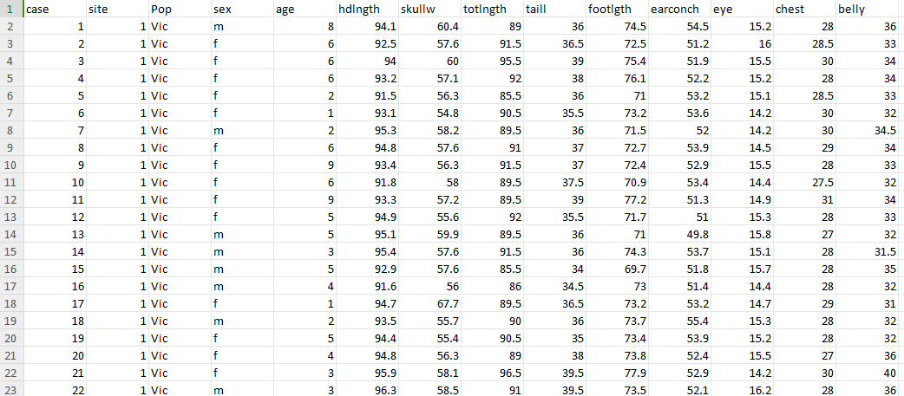
DATA VARIABLES
The variables are of two types:
continuous and categorical data, where the continuous variables are in integer and float format and categorical variables are in object format
DATASET: The data consists of 14 variables and 105 records
SOURCE:https://drive.google.com/drive/folders/1vGSRCnhqSxEH53BgLqhh32F1qNKqfOim?usp=drive_link
Integer | Float | Object
case | age | pop
site | hdlngth,eye | sex
 | skullw totlngth
 | taill
 | footlngth
 | eaarconch
 | Chest,belly

Slide 9

DATA CLEANING
Checking the Unique Values:The unique values of all the columns are identified.
Identifying Null Values: The data is analysed for any missing value or null value.
Replacing the Null Values: The null values which are found are then replaced with suitable values like mean/

Slide 10
To perform dummy variable encoding we divided the data into two sets, which are independent variables and dependent variables
The categorical variables are encoded into continuous variables using the dummy variables
Renaming the columns, the dummy columns are
ORGINAL VARIABLE NAMES | RENAMED VARIABLE NAMES
pop | pop_other
sex | Sex_m

Slide 11

EXPLORATORY DATA
ANALYSIS

Slide 12
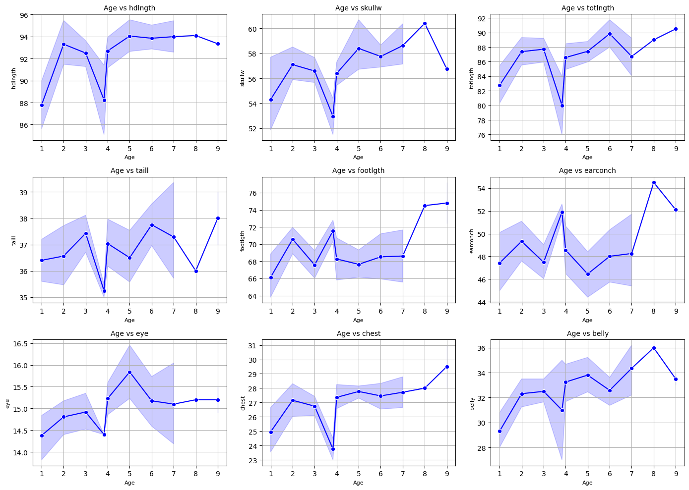
LINEPLOT
The target variable “age” is plotted against all the independent variables in the line plots as shown below.

Slide 13
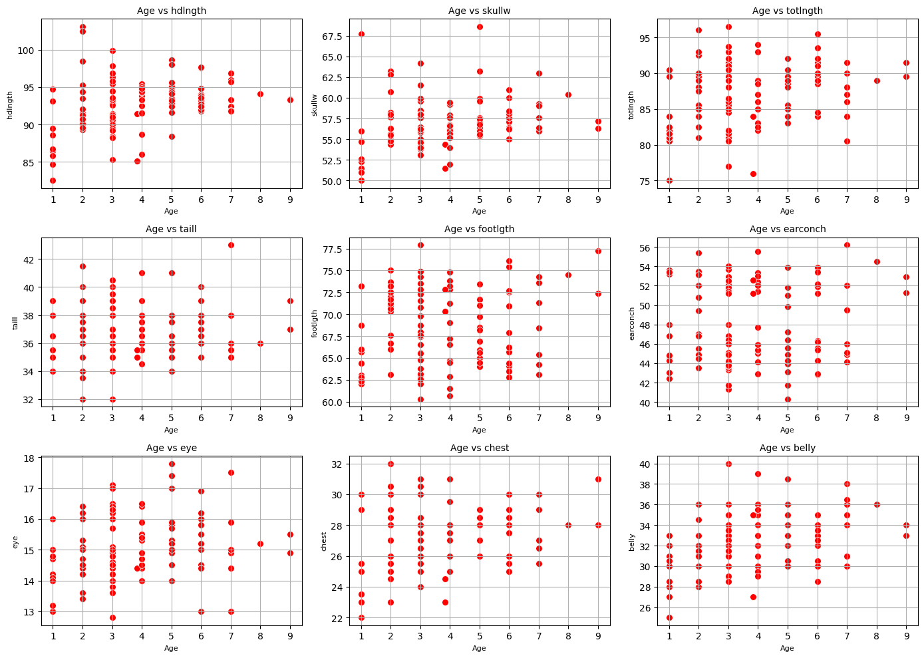
SCATTERPLOT
The target variable “age” is plotted against all the independent variables in the scatter plot shown below.

Slide 14
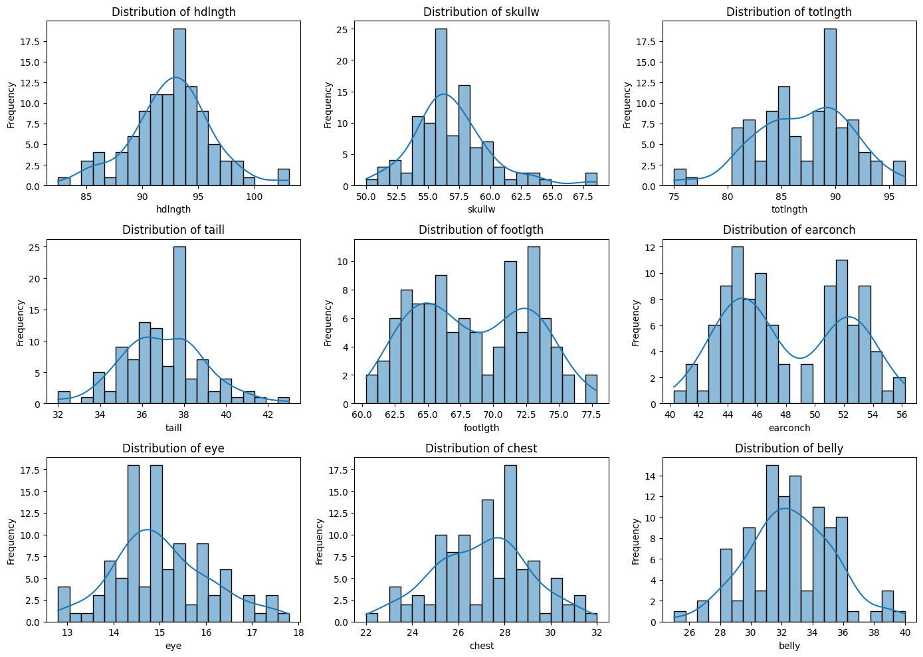
HISTOGRAM
The target variable “age” is plotted against all the independent variables in the histogram shown below.

Slide 15
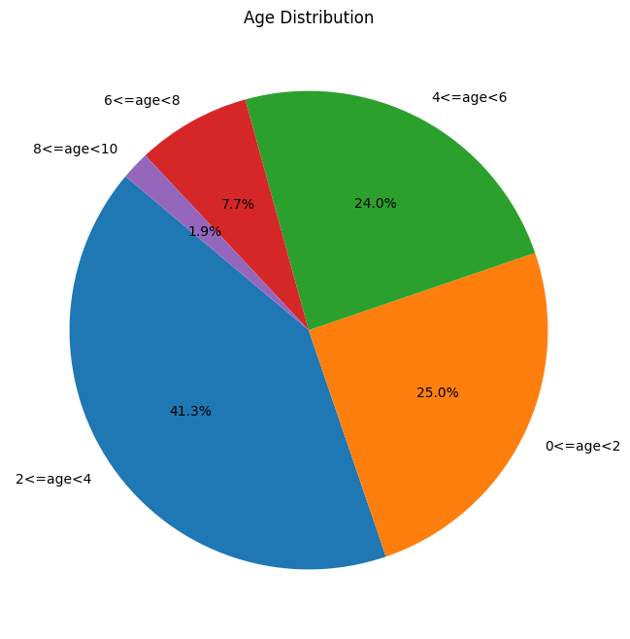
PIECHART
The pie chart below shows the distribution in the “age” column.

Slide 16
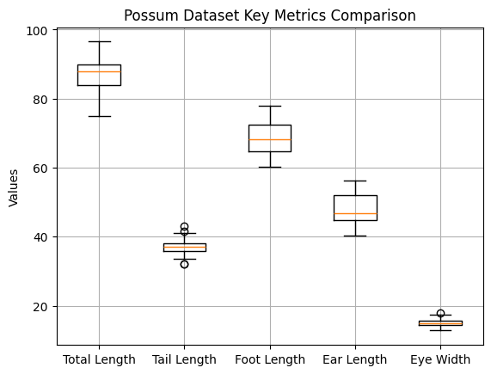
BOXPLOT
The boxplot below shows the possum dataset key metrics comparison.

Slide 17
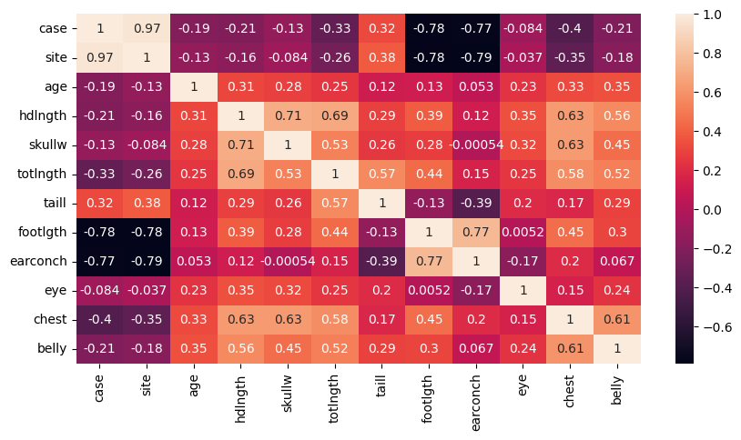
CORRELATION MATRIX
Here we can observe that case and site have high positive correlation.
The next most positively correlated are headlength(hlngth) and skullwidth(skullw).

Slide 18
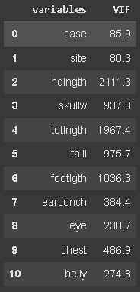
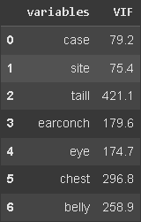
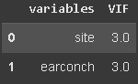
MULTICOLLINEARITY CHECK
The variables in this dataset are highly correlated with each other as we are only left with 2 variables at last after performing the Multicollinearity Test. Hence performing Multicollinearity Test for this dataset is not suitable

Slide 19

MACHINE LEARNING ALGORITHMS

Slide 20
LINEAR REGRESSION
KNN
ML ALGORITHMS
SVM
DECISION TREE
RANDOM FOREST
ADABOOST
XGBOOST

Slide 21
60:40 Train-Test Split
Algorithm | MAE | R2_score
Linear Regression | 1.530 | 0.072
KNN | 1.622 | 0.037
SVM | 1.659 | -0.063
Decision Tree | 1.591 | 0.014
Random Forest | 2.047 | 0.204
AdaBoost | 1.461 | 0.098
XGBoost | 1.398 | 0.272

Slide 22
70:30 Train-Test Split
Algorithm | MAE | R2_score
Linear Regression | 1.345 | 0.150
KNN | 1.520 | 0.035
SVM | 1.401 | 0.118
Decision Tree | 1.307 | 0.147
Random Forest | 2.759 | 0.273
AdaBoost | 0.975 | 0.429
XGBoost | 1.258 | 0.283

Slide 23
75:25 Train-Test Split
Algorithm | MAE | R2_score
Linear Regression | 1.449 | 0.148
KNN | 1.617 | 0.033
SVM | 1.543 | 0.149
Decision Tree | 1.339 | 0.235
Random Forest | 1.339 | 0.239
AdaBoost | 1.588 | 0.044
XGBoost | 1.403 | 0.139

Slide 24
80:20 Train-Test Split
Algorithm | MAE | R2_score
Linear Regression | 1.525 | 0.104
KNN | 1.665 | 0.016
SVM | 1.582 | 0.124
Decision Tree | 2.047 | -0.599
Random Forest | 1.522 | 0.122
AdaBoost | 1.413 | 0.108
XGBoost | 1.530 | 0.003

Slide 25
ALGORITHM COMPARISION
ADABOOST FOR 70:30 SPLIT
Algorithm | MAE | R2_SCORE
Linear Regression | 1.345 | 0.150
KNN | 1.520 | 0.035
SVM | 1.401 | 0.118
Decision Tree | 1.307 | 0.014
Random Forest | 2.759 | 0.273
AdaBoost | 0.975 | 0.429
XGBoost | 1.258 | 0.283

Slide 26
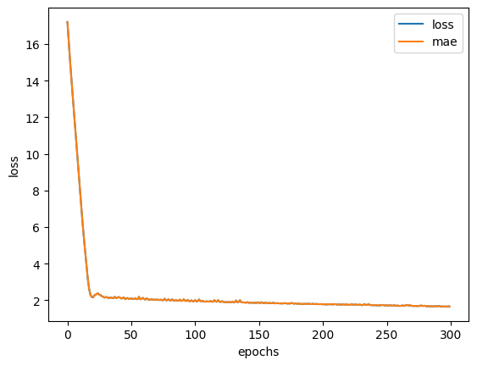
ARTIFICIAL NEURAL NETWORK:
Training Metrics: Loss and MAE for best split 75-25
SLPIT | ARCHITECTURE | OPTIMIZER | EPOCHS | MAE
60-40 | 10-7-5-1 | Adam | 300 | 1.47
70-30 | 10-7-5-1 | Adam | 250 | 1.46
75-25 | 10-7-5-1 | Adam | 300 | 1.33
80-20 | 10-7-5-1 | Adam | 250 | 1.54

Slide 27
-
CONCLUSION
The primary goal of this research is to predict the age of a possum based on its body measurements and gender.
In our study, we applied both Machine Learning (ML) models and a Deep Learning model to build a predictive model for possum age based on its morphometric data.
Among the ML models, the Adaboost algorithm demonstrated the best performance, achieving the lowest Mean Absolute Error (MAE) value of 0.975.
For Deep Learning, we used only the Artificial Neural Network (ANN) model, which showed a slightly higher MAE value of 1.33, indicating relatively lower accuracy compared to the ML model.
Thus, we conclude that the ML model (Adaboost) outperforms the Deep Learning model (ANN) in terms of predictive accuracy for this dataset

Slide 28
INSIGHTS
Key Findings: Strong correlations observed between head length & skull width; multicollinearity limited usable predictors.
Best Model: AdaBoost (70:30 split) outperformed other algorithms.
Practical Use: Predictive modeling aids in species identification and ecological research.
Challenges: Multicollinearity and small dataset size impacted results.
Future Steps: Enhance dataset size and apply advanced feature selection
FUTURE SCOPE
Expand dataset size and include more features.
Address multicollinearity using advanced techniques.
Optimize models with ensemble methods and tuning.
Apply models for species identification in ecology.
Develop tools for real-time predictions

Slide 29

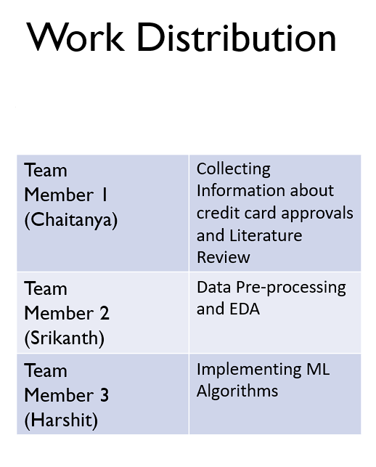

Slide 30

COLAB LINK
THANK YOU
B.HARSHIT KUMAR
SRIKANTH YADAV
CHAITANYA JADAV

Slide 31
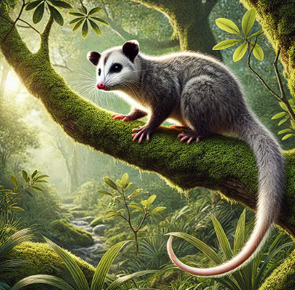
APPENDIX

Slide 32
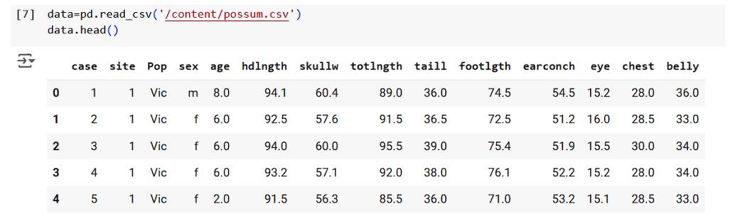
LOADING DATASET

Slide 33
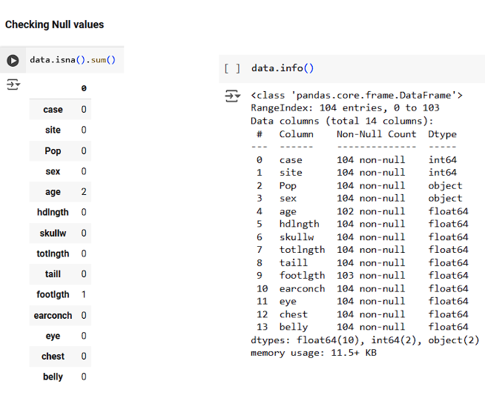
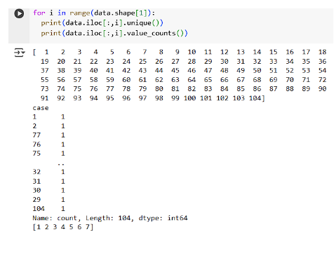
CHECKING DATATYPE
FINDING UNIQUE VALUES

Slide 34
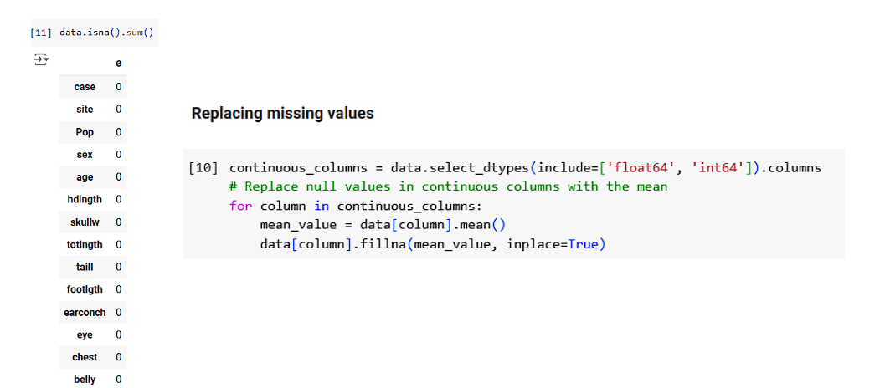

Slide 35
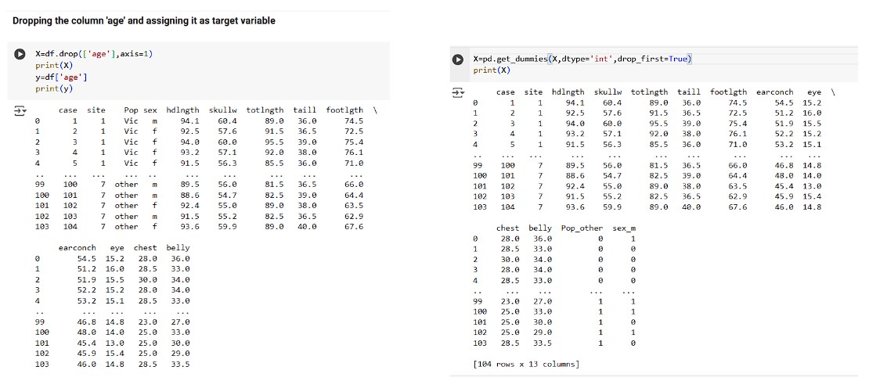
CREATING DUMMY VARIABLE

Slide 36
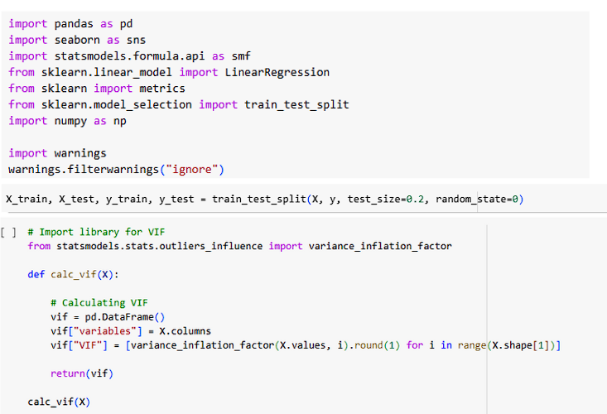
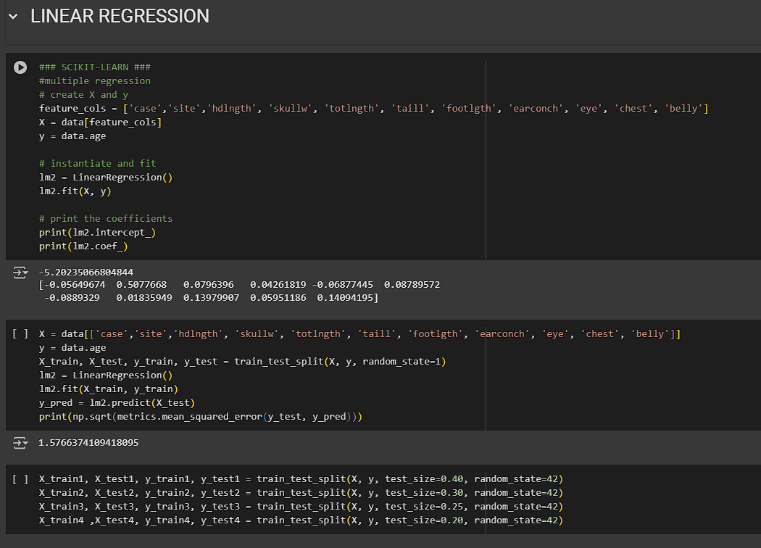
LIBRARIES
ML Models

Slide 37
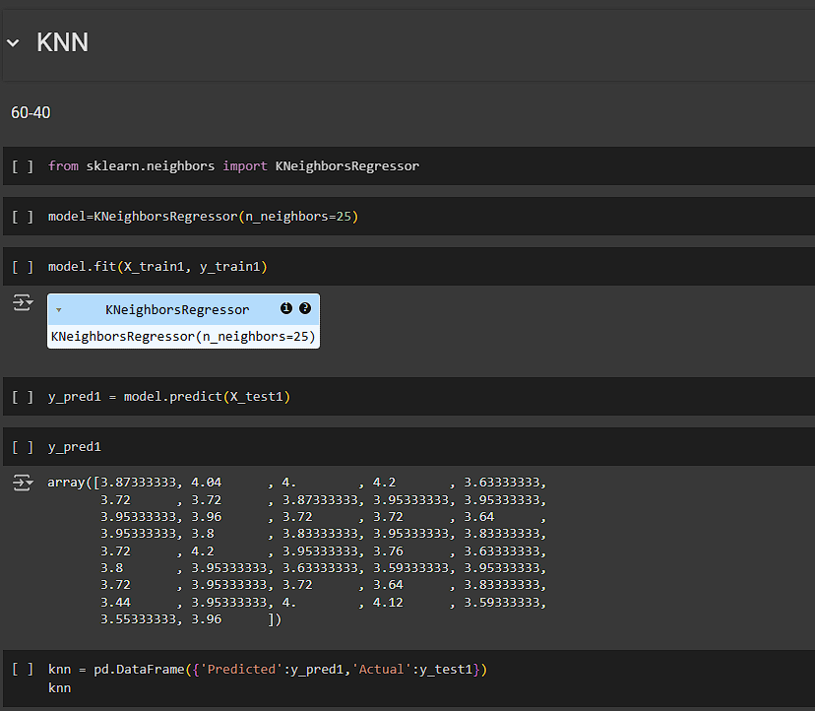
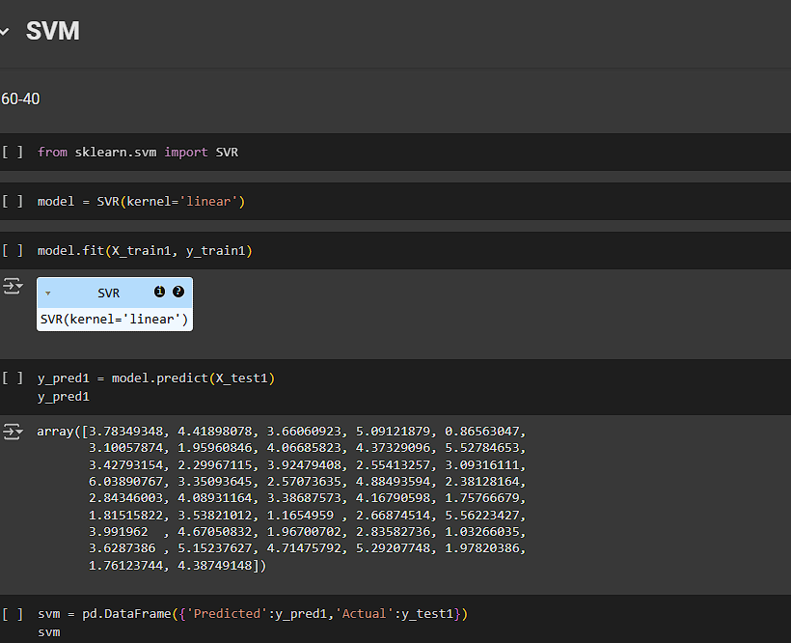

Slide 38
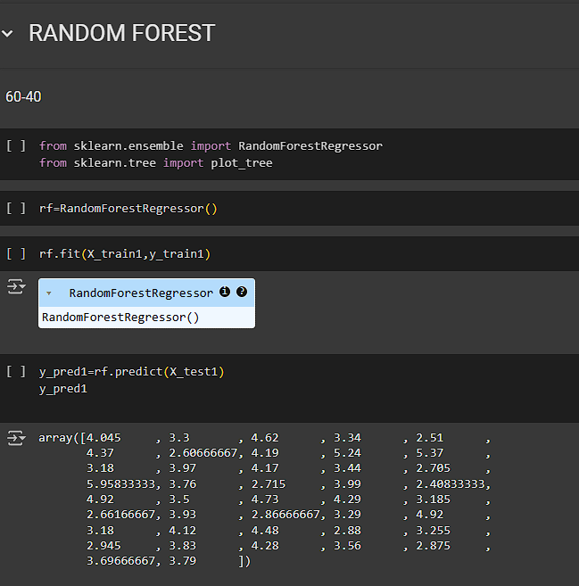
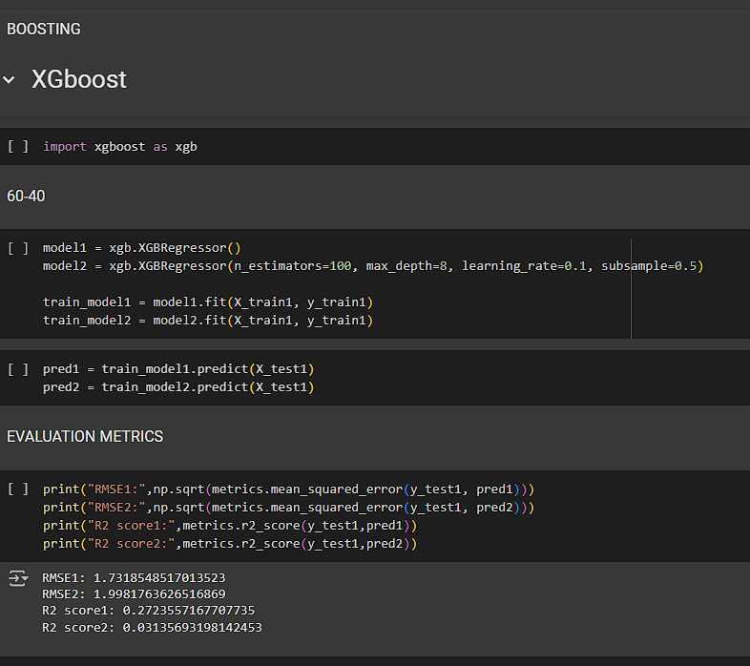

Slide 39
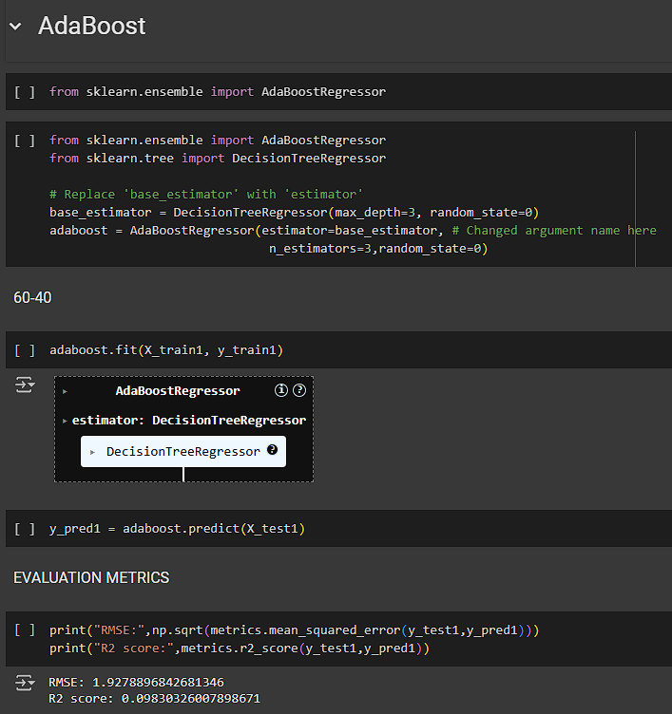
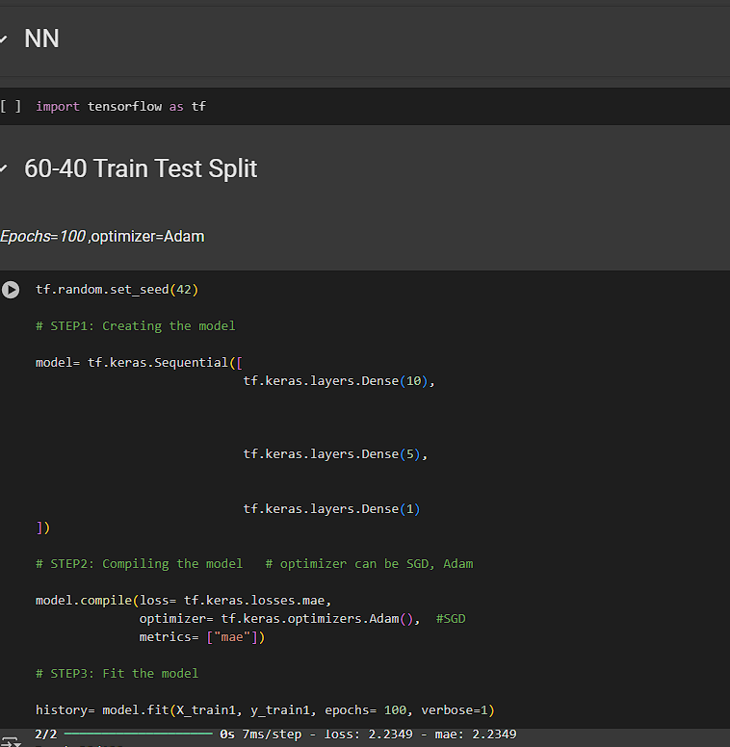
DEEP LEARNING MODEL(ANN)

